Slide 1

Airline Reservation System
Presented By :
Hamid Abdullah
Ahmed Tariq
Zeeshan Jamil
Database Semester Project

Slide 2

Table of contents
Introduction
Problem Statement & Motivation
Objectives
Core Features & Functionality
Demo
Testing & Validation
Challenges & Lessons Learned
Future Work And Conclusion

Slide 3
Introduction
Overview : The Airline Reservation System helps user book, view, and cancel tickets easily. It makes managing flights and bookings faster and simpler for users.
Purpose : Main purpose behind choosing this project was to simplify the booking process by providing simple interface to users.

Slide 4
Problem Statement And Motivation
Problem Statement: Manual airline booking processes are time-consuming and prone to errors. Customers lack a user-friendly interface for flight schedules, bookings, and cancellations.
Motivation:
To simplify the booking process for both customers and staff.
Provide a user friendly interface to improve customer experience.
Practice OOP Concepts by implementing then in real world scenario.

Slide 5
Objectives
Enable customers to book tickets easily.
Provide a user-friendly interface for customers to cancel booking.
Ensure real time updates to schedule, bookings and cancellations.
Also ensure real time updates of schedules ,bookings.
Create a project that can be improved in the future.

Slide 6

Core Features And Functionality
Flight Schedule : User Should be able to see flight Schedule
Booking : User Should be able to book ticket by providing necessary info.
Search Flights : User should be able to search for flights by date, cities and FlightNo.
Cancel Booking : User should be able to cancel Tickets effectively by providing necessary details.
Journey Details/E-Ticket : user should be able to see his
journey details or E-Ticket

Slide 7
Testing & Validation
Unit Testing:
We have tested all classes separately and all are working properly .
For Example : Login, Booking , SearchFlights etc.
Integration Testing:
After integrating each class we have tested whole project in sequence and it was working perfectly.
Validation :
We have validated our project by providing specific inputs and getting corresponding results.

Slide 8
Challenges & Lessons Learned
Challenges :
We had faced problem in Database Connectivity
Difficulty in identifying all the features required for an Airline Reservation System.
Lessons Learned :
Time Management
Testing and Debugging

Slide 9
Future Work & Conclusion
Future Work :
AI chat Bot: We can add AI chat bot to it through which user could ask any relevant questions related to flights and many other things.
Frame works: We can use Frame works like react, node.js and java script in future to give it a more professional look
Add functionality for staff : In future we can enhance the project to include functionality for staff so they can manage schedule and other things.

Slide 10
Failure and Recovery in Transaction Management
.
FAILURES:
System Crash: Due to power failure or OS crash.
Transaction Failures: Logical errors (e.g., invalid input) or system errors (e.g., deadlock).
Media Failures: Disk crashes or data corruption.
Communication Failures: Network issues in distributed systems.

Slide 11
Recovery Mechanisms :
Write-Ahead Logging (WAL): Logs changes before actual updates, aiding rollback or redo.
Checkpointing: Saves the database state at intervals to minimize recovery time.
Undo/Redo Operations:
Undo: Reverses uncommitted changes.
Redo: Reapplies committed changes after a crash.
Goal: Ensure database integrity and consistency after unexpected failures.

Slide 12
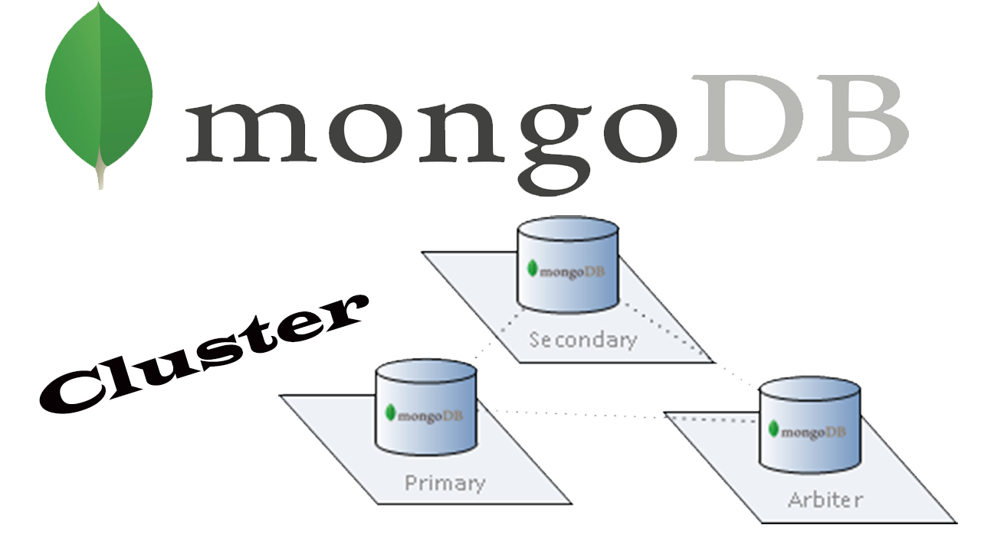
MongoDB Sharding and Replication
Replication:
Ensures high availability and data redundancy.
Uses Replica Sets: A group of MongoDB servers with:
Primary node (handles reads/writes)
Secondary nodes (sync data from primary)
Automatic failover if the primary fails
Benefits: Fault tolerance, automatic recovery, read scaling (via secondary reads).
This Photo by Unknown Author is licensed under CC BY-NC

Slide 13
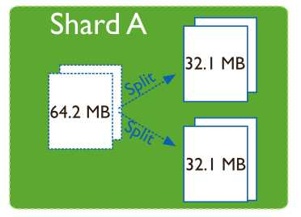
Sharding :
Enables horizontal scaling by distributing data across multiple machines.
Shards: Individual MongoDB instances holding a subset of data.
Shard Key: Determines how data is partitioned.
Config Servers: Store metadata and cluster configuration.
Query Router (mongos): Directs queries to the appropriate shard.

Slide 14
BENIFITS
Supports massive datasets.
Increases read/write throughput.
Enables elastic scalability.

Slide 15
Conclusion
Conclusion :
In conclusion our project contain following things
In this project our main object was to create a user friendly interface
Database Integration and Management
Dynamic Data fetching from database
Basic functionalities of an airline system

Slide 16
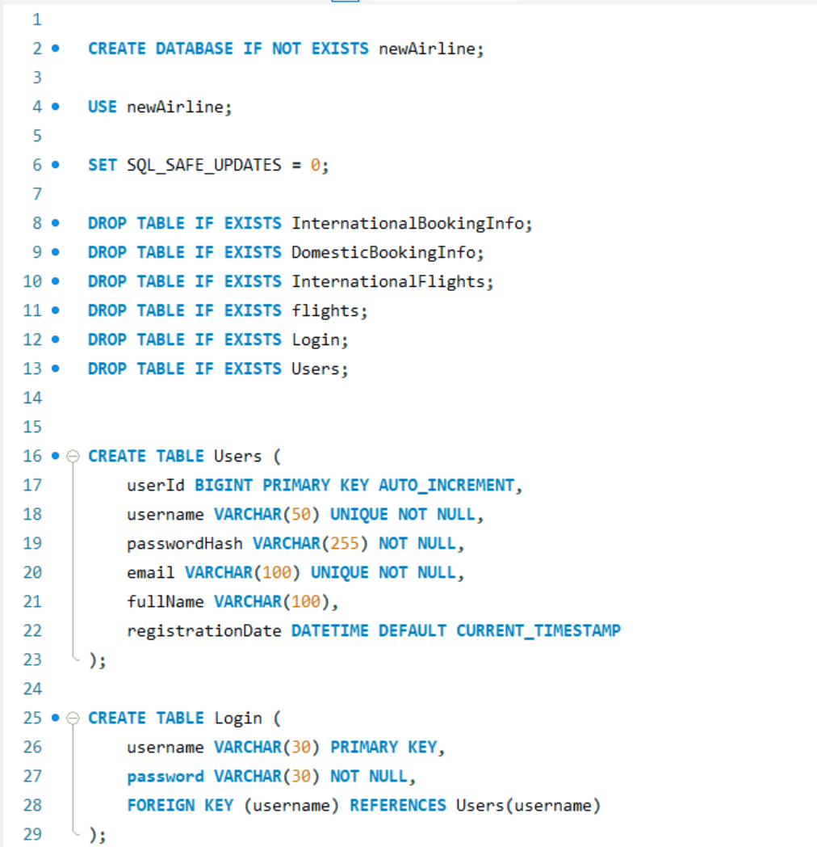
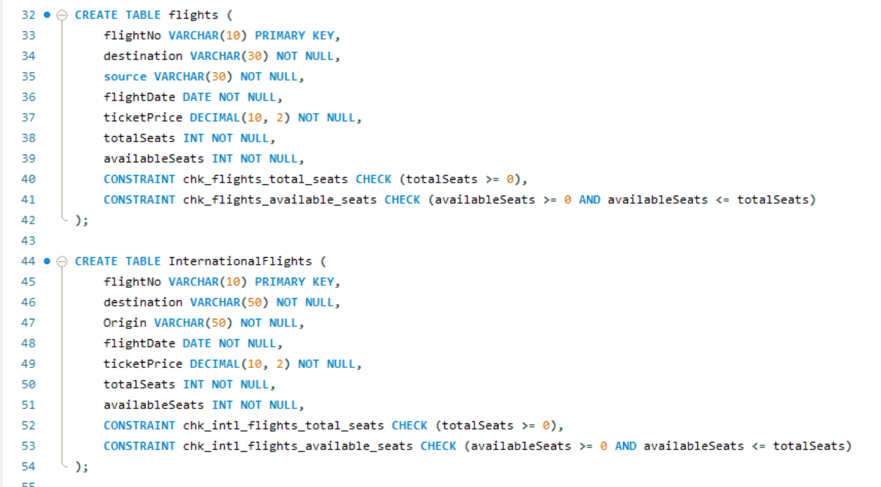
Source Code:

Slide 17
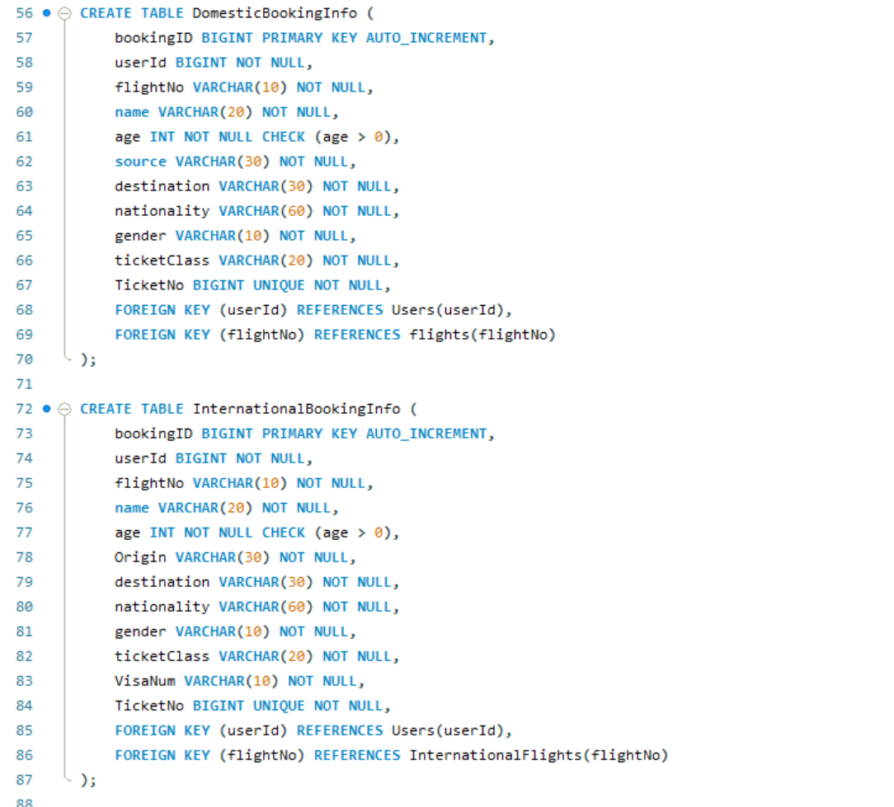
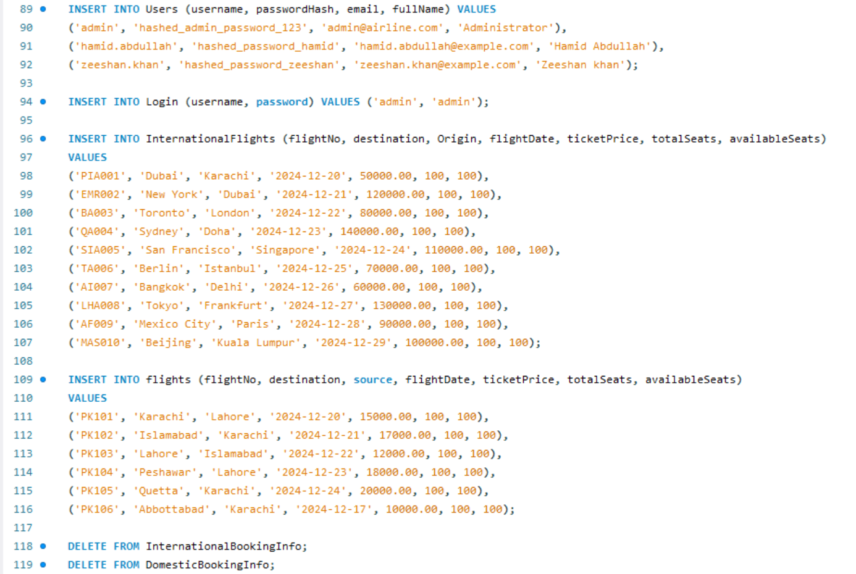

Slide 18
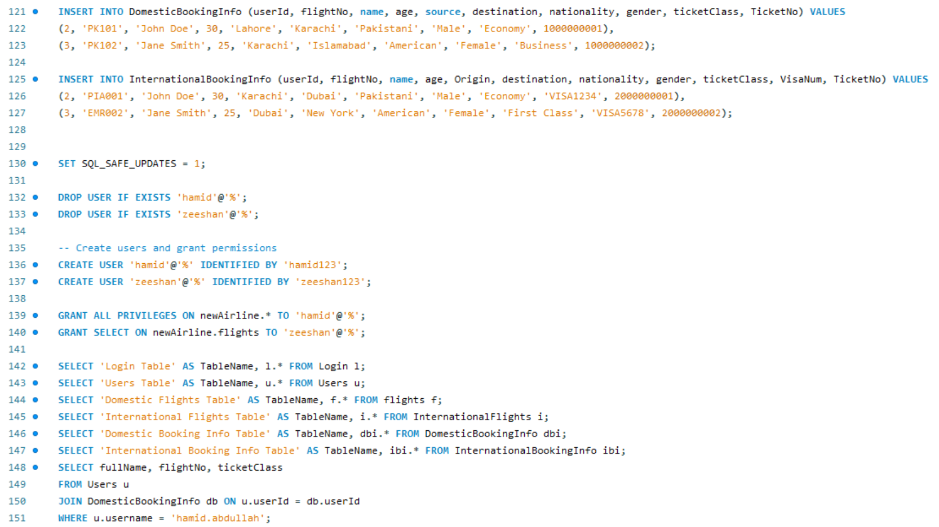

Slide 19
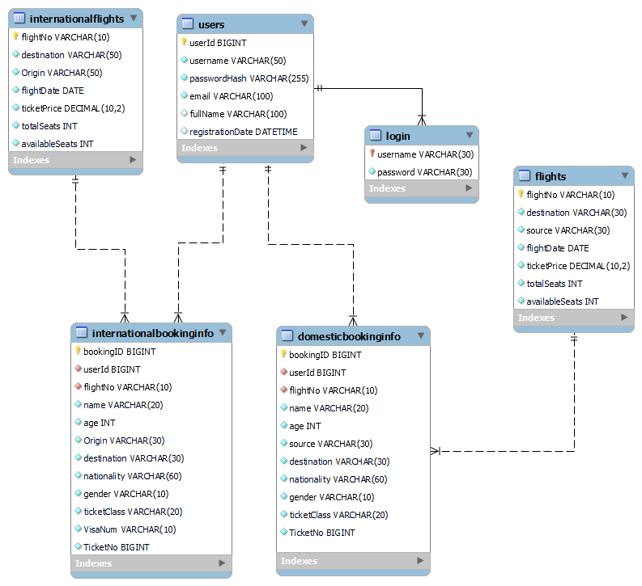
ERD:

Slide 20
Thank You

